Slide 1
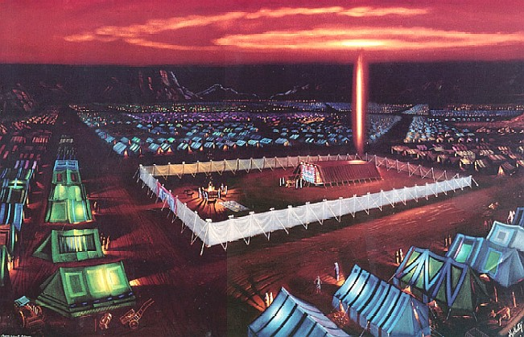
G-D’s people in the Sinai Dessert
✵ Song of Freddy Hayler © ‘
Golden Altar Worship
Then a cloud covered the tent of the congregation, and the glory of the Lord filled the tabernacle. (Exodus 40:34)The cloud and the glory of God filled the tabernacle when all things were completed, anointed, sanctified, and made Holy for Divine services and the Divine Presence.
ENTER  t or  to activate slide show

Slide 2
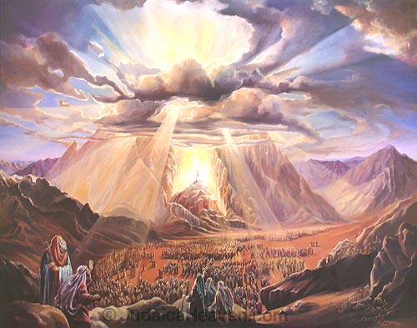
The Tabernacle of Moses
G-D wants to dwell among His people!
It’s historical from the Book of Exodus.
There are deep “spiritual” insight and pictures inside!
The picture of the Tabernacle; and the agony sacrifies of Yeshua
How you can enter the Holy of Holiest and to experience to be face to face to the very G-D Himself!

Slide 3
Holy of Holies Ministries
Presentation
An unique Radical Worship

Slide 4
Holy of Holies Ministries
The Shekinah Glory of G-D!
Here G-D, condescending to dwell in Israel, commanded that a special dwelling be lifted up for Him where His presence could be manifest daily to them, and from which He would commune with them through Moses and the high priests in generations to come (Exodus 25:8-9). Every part of the tabernacle was typical of the nature of G-D, the coming redemption, the sinfulness of man, the means of pardon through grace, and the full reconciliation of man to G-D!

Slide 5
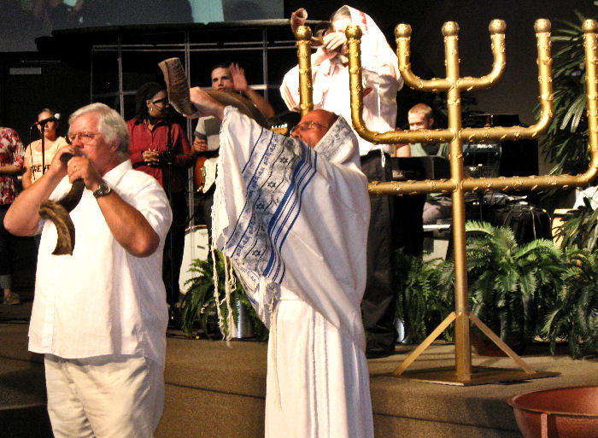
Shofar-blowing at the begin of the Worship
God’s Outreach Ministry Int. Inc. ©

Slide 6
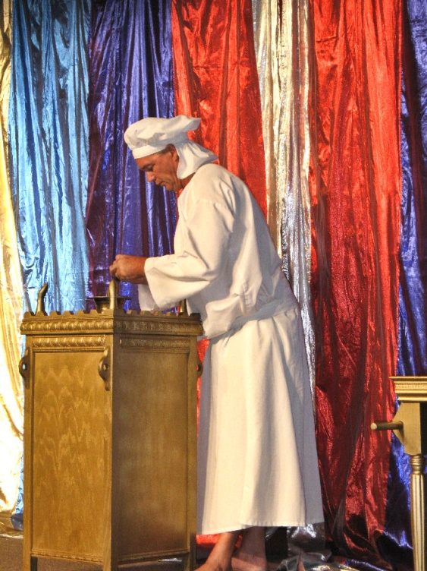
Three commands—making the tabernacle:
1. Make Me a sanctuary 2. Make it like the pattern you were shown on the mount
(Exodus 25:9, 40; Hebrews 8:5) 3. Make the furniture like the pattern you were shown
(Exodus 25:9, 40)
Sanctuary is a consecrated Holy place, referring to the Holy of Holies of the heavenly temple or tabernacle! The tabernacle made by Moses refers after the patterns shown him of heavenly things!
After this I will return, and will build again the tabernacle of David, which is fallen down; and I will build again the ruins thereof, and I will set it up: That the residue of men might seek after the Lord, and all the Gentiles, upon whom My Name is called, said the Lord, who doeth all these things.
(Acts 15:16, 17)

Slide 7
The Holy of Holies Ministry was begun in 1994 in Tallahassee; Florida, by Dr. Stan J. Kmet and his wife Marci at Christian Heritage Church. They shared the vision to take a replica of the Moses’ Tabernacle of the Congregation into the Church Body so that the Body could see first-hand the many New Testament lessons that God designed into Moses’ Tabernacle.

Slide 8
Dr. Stan Kmet thoroughly researched the Tabernacle itself and its elaborate furnishings in order to come up with the many teachings and illustrations about the Tabernacle of the Congregation that soon became a part of the Holy of Holies Ministry. Over more than 77.000 people have been ministered to and have experienced the Presence of the Living G-D!

Slide 9
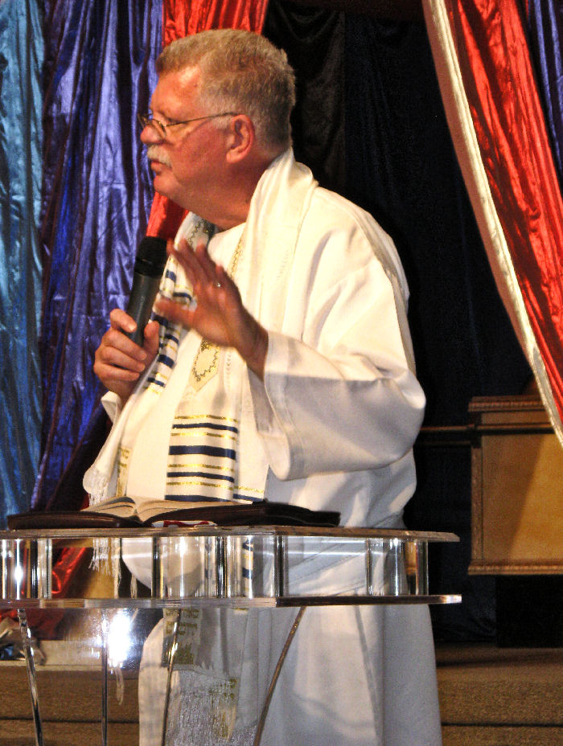
In January of 1996 the Lord began to unfold and speak profoundly concerning the “Holy of Holies Ministry” and His purposes. He made it very clear that He would use the ministry as an avenue in “Rebuilding the Tabernacle of David” during these last days. “We have seen an increase of anointing, and praise and worship is one of the major keys”. Giving the remnant of men an opportunity to seek God and worship Him in Spirit and in Truth!
God’s Outreach Ministry Int. Inc. ©

Slide 10
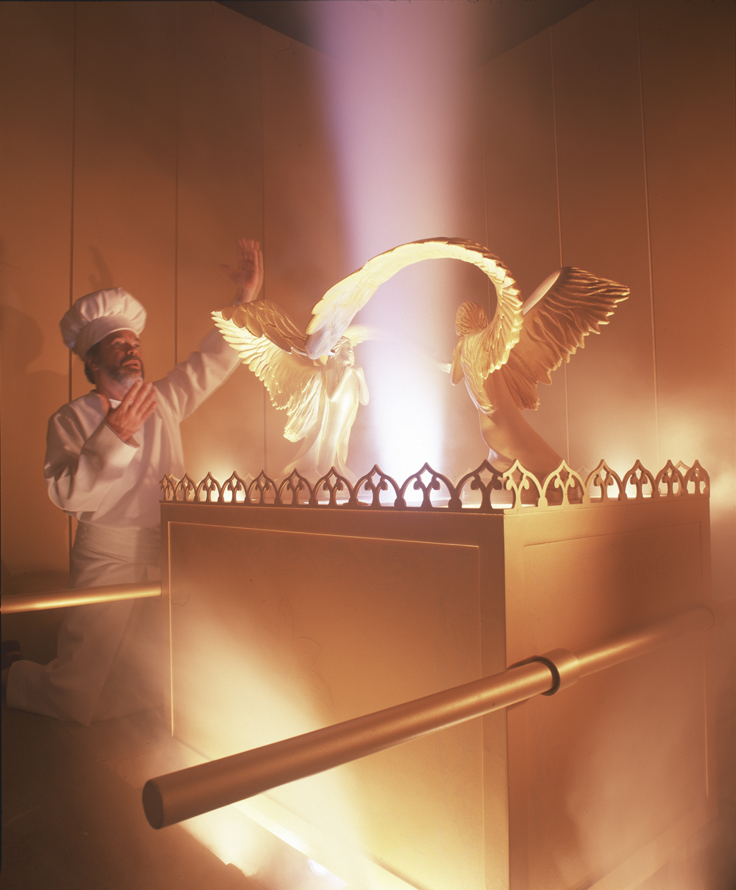
“The skekinah” Glory of G-D!
Because of the efforts of the Holy of Holies Ministry, many within the Church have come to see the significance of Moses’ Tabernacle as it relates to their pursuit of God into the Tabernacle’s inner sanctum, the Holy of Holies! Through the practical applications within the Holy of Holies Ministry, many believers have learned how each piece of the Tabernacle Furniture had a lesson to teach that led the pursuant into the Presence of God within the Holy of Holies

Slide 11
This unique Ministry combines the foreshadow of Jesus Christ (Yeshua) found in the structure and furniture of the Tabernacle that God gave Moses with the radical praise and worship that David’s Tabernacle possessed!
God’s Outreach Ministry Int. Inc. ©

Slide 12
The heart of the Holy of Holies Ministry is actually unparalleled in today’s ministry. On a number of occasions I have personally witnessed the group worship and praise the Lord for well over an hour until they pressed into His Holy Presence, and minister to the hurting souls until every last one of them had felt a personal touch from the Lord.

Slide 13
7 mayor reasons for Radical Worship shortly...
Personal Experiences of His Shekinah Presences!
2. Praise & devoted passionate radical worship had its roots in the O.T.!
3. Heartfelt & devoted passionate radical worshippers!
4. God is in charge!
5. Practical visible teachings of the Tabernacle of Moses!
6. God’s move to rebuilt “David’s Tabernacle” within the hearts of Believers!
7. The Conferences included…

Slide 14
The musicians, singers, and worshippers of Yahweh have always been G-D’s means of preparing the way for the coming of the Heavenly Host! Primarily because pure worship arises from the heart felt cries of repentant souls wanting nothing more than to rest within their Father’s Loving Embrace!

Slide 15
The altimade sacrify of Yeshua Messiah! A place of repentance and reconcilliation! COMING TO THE ALTAR OF SACRIFY!

Slide 16
Your first entrance is the “Brazen Altar”! Referring to the Cross of Yeshua!
Holy of Holies Ministries

Slide 17
The altimade sacrify of Yeshua Messiah! A place of repentance and reconcilliation! Referring TO THE CROSS OF YESHUA MESSIAH!
A-B

Slide 18
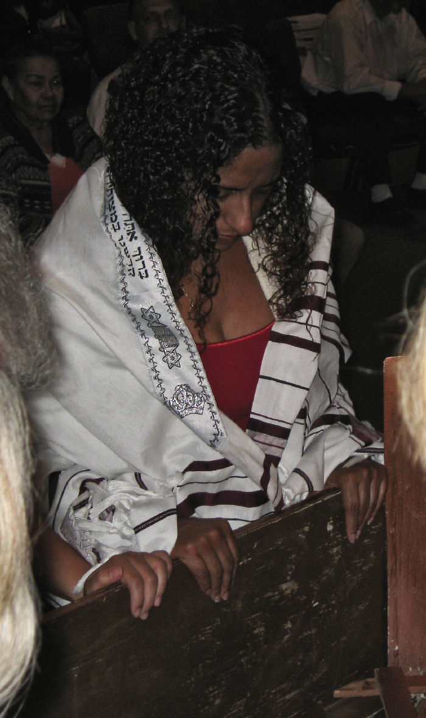
Coming in humility; Before His Altar,
Before His Cross, His Throne…..
…Entering in His Shekinah presence!
God’s Outreach Ministry Int. Inc. ©

Slide 19
A-B
The “Laver of Water” washing “yourself” your hands & feets.

Slide 20
Symbolic for cleaning yourself into the “Word” of G-D!
God’s Outreach Ministry Int. Inc. ©

Slide 21
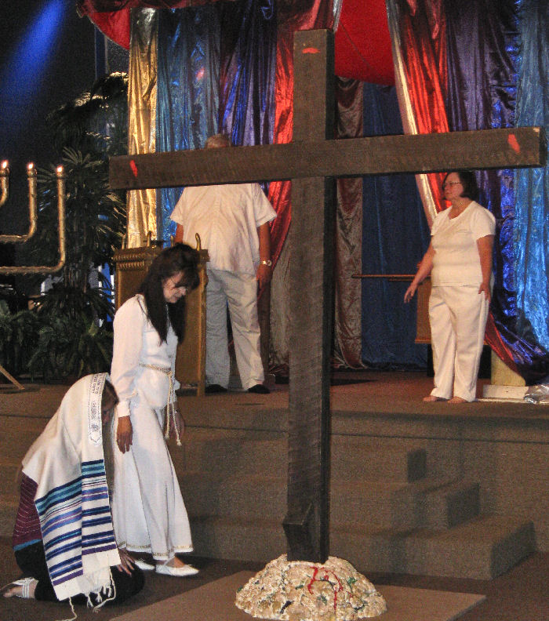
Each aspect of the crucifixion is a scene from the past; a type from the OT Law being acted out and fulfilled by Yeshua Messiah Himself! We would look in vain in the New Testament Scriptures for a fulfillment by the Church, because the Church owes no atonement. "She" is not innocent, but exonerated. Now Yeshua has paid all our sins! Yeshua Messiah is our High Priest as declared in:(Hebrews 4:14-16)

Slide 22
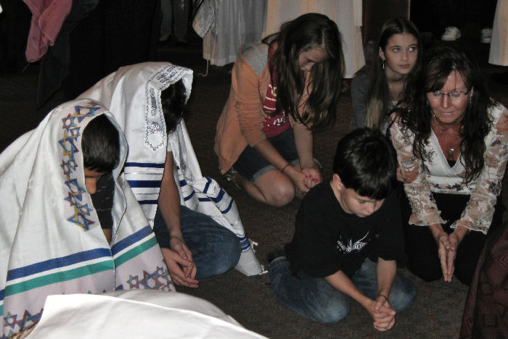
For His Divine rule in the hearts of those who acknowledge Him as Sovereign Lord! Yeshua had to beaten to get mercy for us! (Hebrews 5: 8-10; 9: 3-8) Receiving by grace His Glory and being in His Divine presence!

Slide 23
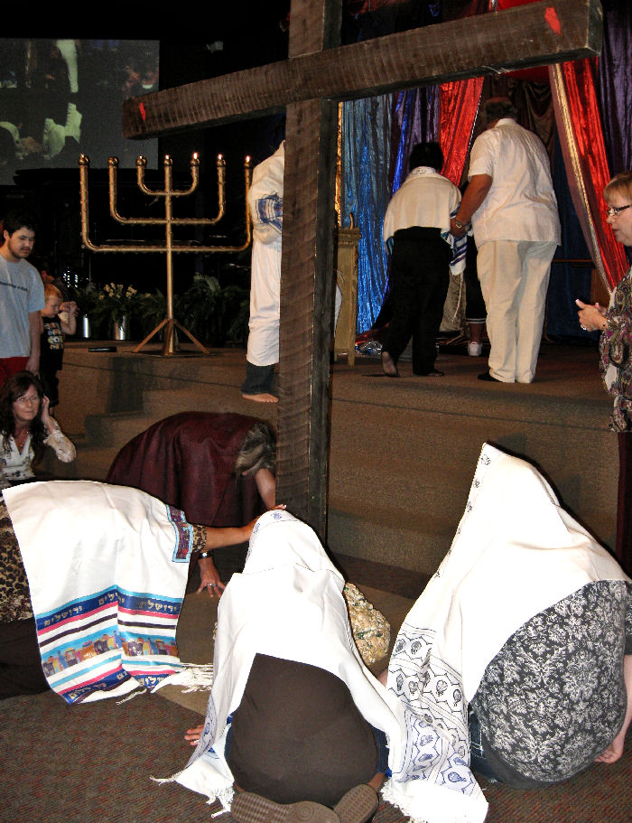
Coming in humility before His cross entering in His Divine presence!

Slide 24
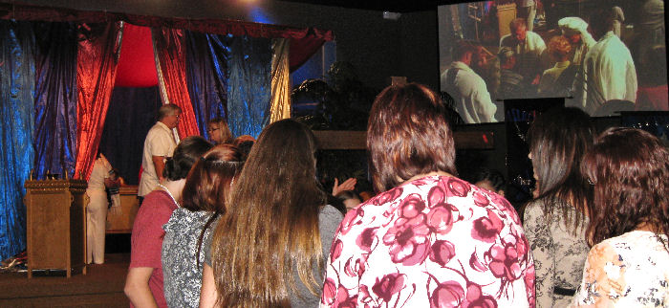
Coming in humility!

Slide 25
Entering into His Shekinah Presence…
It was a sign from Heaven, that men & women were chosen by G-D, for a very specific task and to be anointed. They are separated for ready to be activated by G-D to perform their tasks during their life on these last days of planet Earth.
God’s Outreach Ministry Int. Inc. ©

Slide 26
Likewise the 24 Elders in Heaven!
Just like the 24 Elders in Revelation 11, we need to worship the very G-D of the Universe before His Throne in His Heavenly Temple. Alike the 24 Elders are redeemed men in Heaven all through the time of their fulfillment…
God’s Outreach Ministry Int. Inc. ©
Picture-source with permission www.Revelationillustrated.com

Slide 27
Come to My appointed secret place! This is the place where I was waiting for so long for you! I want also to be your best friend and take your hand for a walk and show you My glory. I will heal you! I want to fight for you!* My Blood is shed for you! My stripes brought your healing**. Accept it! ….
End-Time-Harvest-Revival

Slide 28
Demonstration of the Ark of Covenant
Like David was dancing before the Ark
Priests performance, to carry the Ark of the Covenant, in the procession with this Ark.

Slide 29
Demonstration of the Ark of Covenant
Priests performance, to carry the Ark of the Covenant, into the Holy of Holies.

Slide 30
Priest leaving the Holy of Holies
Priests performance, they just left the Holy of Holies, to place the Ark of the Covenant, after the procession with this Ark.

Slide 31
Priest at the Golden Altar of incense…
Priest performance, they just put the incense on the Golden Altar of smoke incense before the “veil” of the Holy of Holies, to place of the Ark of the Covenant.

Slide 32
Priest at the Golden Altar of incense…
Priest performance, they just put the incense on the Golden Altar of smoke! The Table of showbread is where they put 12 leaves of bread

Slide 33
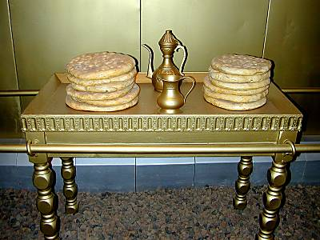
Yeshua replied, I am the Bread of Life. He who comes to Me will never be hungry, and he who believes in {and} cleaves to {and} trusts in {and} relies on Me will never thirst any more (at any time). (John 6:35)

Slide 34
Song of Praise & Worship!
Music and singing were a cherished part of ancient Israel’s culture! It proclaimed G-D’s greatness by giving Him only credit for their victory! Singing praises to G-D. Songs of praise focus our attention on G-D, give us an outlet for spiritual celebration, and remind us of G-D’s faithfulness & character.

Slide 35
Entering into the Holy of Holies...
1. Beyond the inner veil was the Holy of Holies, where centered the symbolic service of atonement and intercession, and which formed the connecting link between Heaven and Earth!

Slide 36
Entering into the Holy of Holies...
2. The cover of the sacred chest was called the mercy seat. This was wrought of one solid piece of gold, and was surmounted by golden cherubim, one standing on each end. One wing of each angel was stretched forth on high, while the other was folded over the body

Slide 37
Entering into the Holy of Holies...
3. Above the mercy seat was the Shekinah Glory, the manifestation of the Divine Presence; and from between the cherubim, G-D made known His will. Divine messages were sometimes communicated to the high priest by a voice from the cloud. Sometimes a light fell upon the angel at the right, to signify approval or acceptance, or a shadow or cloud rested upon the one at the left to reveal disapproval or rejection.

Slide 38
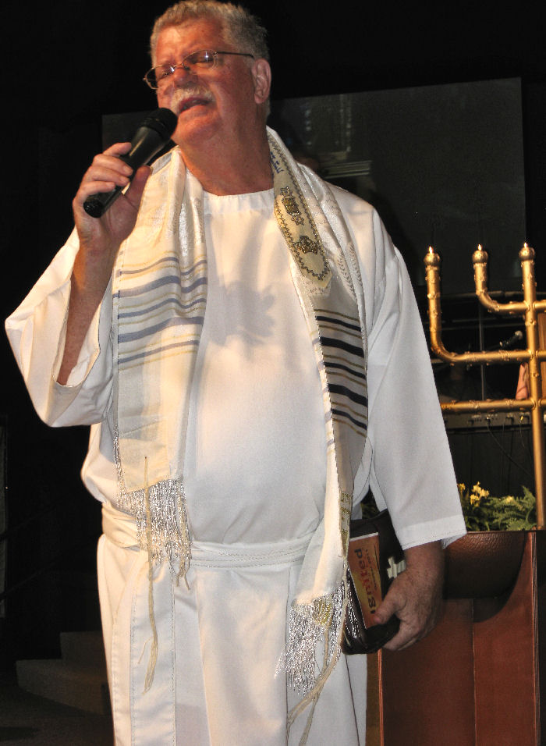
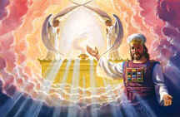
Holy of Holies Ministries
The Shekinah Glory of G-D!
Here you can meet G-D! In Holiness, Worthily, in humility…

Slide 39
Holy of Holies Ministries
The ‘Church’ have come to see the significance of Moses’ Tabernacle as it relates to their pursuit of G-D into the Tabernacle’s inner sanctum, the Holy of Holies!

Slide 40
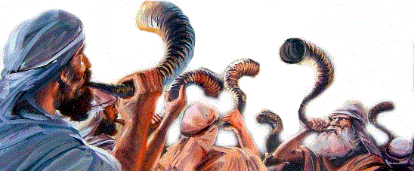
Holy of Holies Ministries
2140 Victory Garden Lane.
Tallahassee; Florida; 32301
Phone: Stan Kmet: (850) 322-0322
This power Point presentation
is created by:
Paul van Beek
www.Endtimeharvestrevival.org
God’s Outreach Ministry Int. Inc. ©
✵ Golden Altar Worship © by Freddy Hayler - Golden Altar Music
With permission to use
www.Songsofangels.com

